Slide 1


SMART FARMING DATABASE MANAGEMENT SYSTEM
PRESENTED BY
2303811714821058 – B.R.VIMAL AANANTH
GUIDED BY
Mr.ROSHAN JOSHUA, AP/AI

Slide 2

PRESENTATION OVERVIEW
Objective
Problem Identification
System Architecture – (Proposed Work Architecture)
Block Diagram
List of Modules
Module Implementation
Module Description
Screenshots
Conclusion and Future Enhancement

Slide 3
OBJECTIVE
The objective of the Smart Farming Database Management System (SFDMS) is to empower farmers with a centralized, intelligent platform that streamlines data collection, monitoring, and analysis to boost productivity and support sustainable agriculture.
Centralize farm data for easy management.
Monitor crops and environment in real time.
Support data-driven decisions and automation.

Slide 4
PROBLEM IDENTIFICATION
Traditional farming relies heavily on manual methods, leading to inefficient resource usage, poor data management, and unpredictable crop yields. The absence of real-time insights makes timely decision-making difficult.
Key Problems:
No real-time data on soil, crops, or weather.
Inefficient use of resources (water, fertilizer, etc.)
Manual record-keeping and limited data access.
Delayed or poor-quality decision-making.

Slide 5
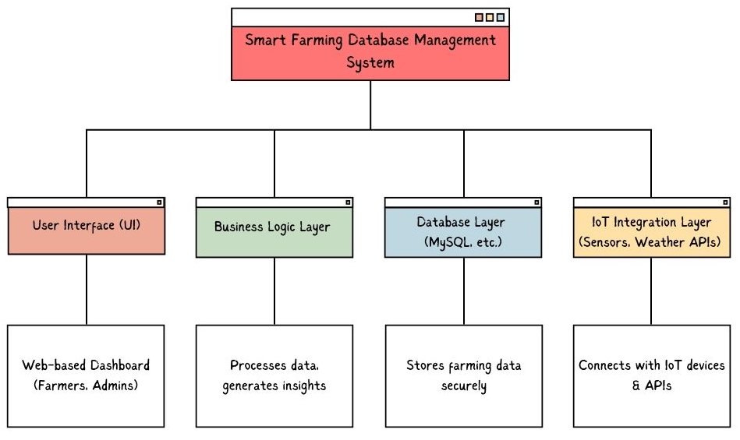
SYSTEM ARCHITECTURE
Proposed Work Architecture

Slide 6
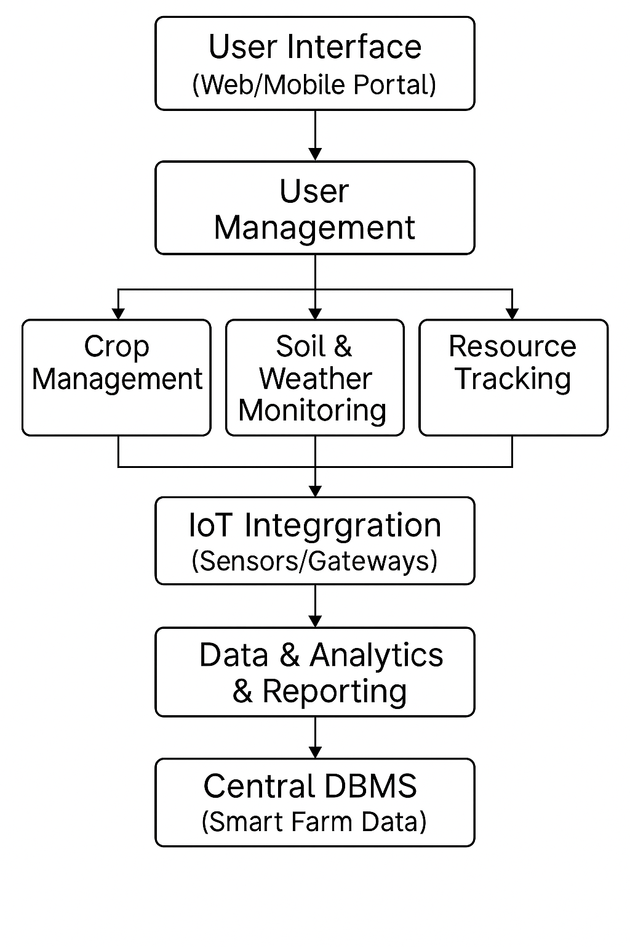
BLOCK DIAGRAM

Slide 7
LIST OF MODULES
User Management.
Crop Management.
Soil and Weather Monitoring.
Resource Tracking.
Alerts and Notifications.
Data Analytics and Reporting.
IoT Integration.

Slide 8
MODULE IMPLEMENTATION
User Management: Manages user login, roles (admin/farmer), and secure access.
Crop Management: Stores and tracks crop details linked to specific farms.
Soil & Weather Monitoring: Saves sensor data like pH, temperature, humidity.
Resource Tracking: Tracks quantity and use of water, fertilizer, pesticide.
Alerts: Adds alerts to the database when abnormal conditions occur.
Reports & Analytics: Uses stored farm data to generate reports.
IoT Integration: Sensors push live data into the database.

Slide 9
MODULE DESCRIPTION
User Management:
Allows users to register, log in, and access the system based on their roles such as admin or farmer.
Crop Management:
Enables farmers to enter and update crop details like name, type, planting and harvest date.
Soil and Weather Monitoring:
Automatically collects and stores data such as soil pH, moisture levels, temperature, and humidity.
Resource Tracking:
Keeps track of the usage and availability of essential resources like water, fertilizers, and pesticides.

Slide 10
MODULE DESCRIPTION
Alerts and Notifications:
Sends alerts when critical conditions are detected, helping users respond quickly to farm issues.
Data Analytics and Reporting:
Generates reports and insights using the collected data to support better decision-making.
IoT Integration:
Connects to sensors that send real-time data directly into the system, reducing manual input.

Slide 11
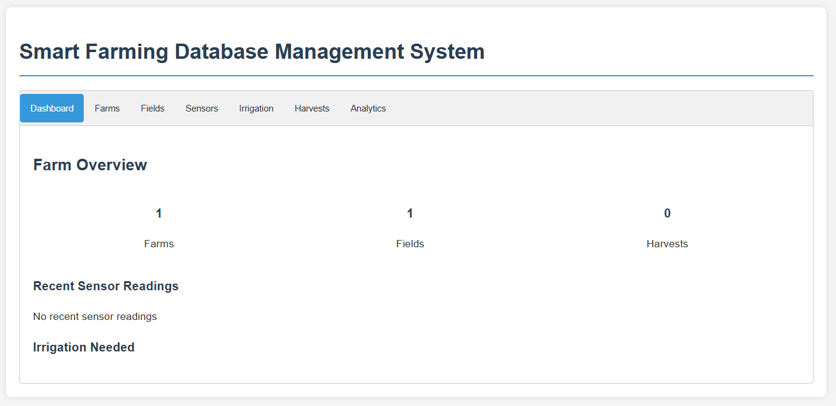
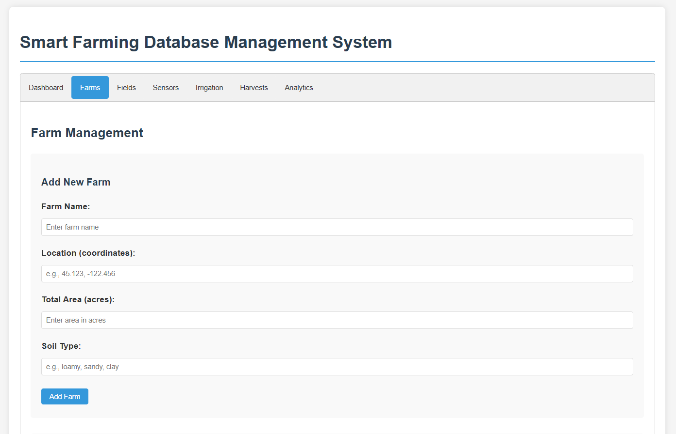
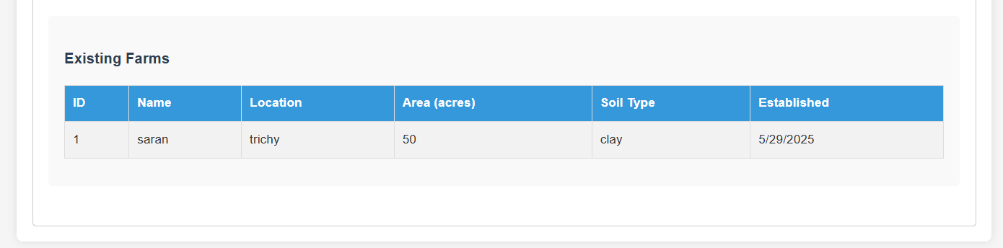
SCREENSHOTS
INTERACTIVE DASHBOARD
FARM MANAGEMENT

Slide 12
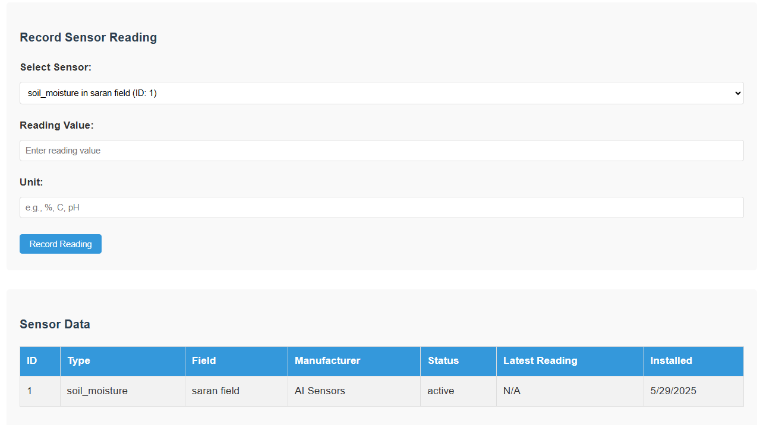
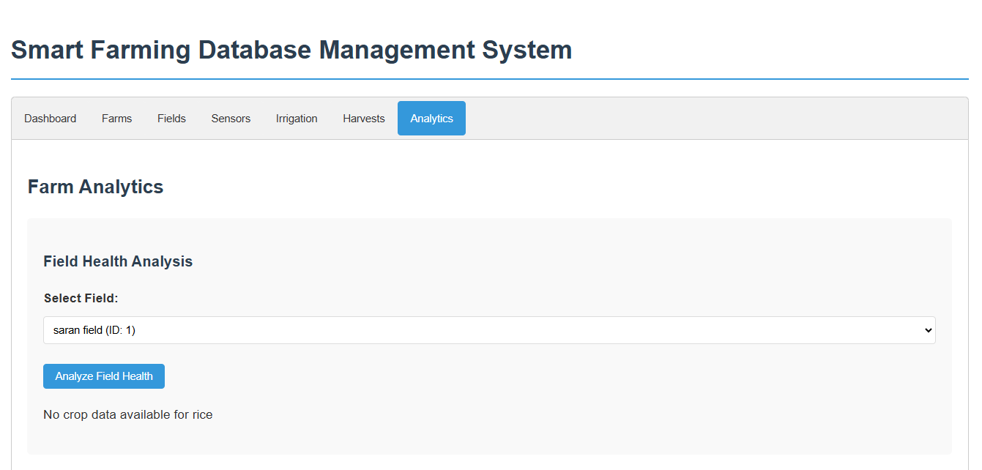
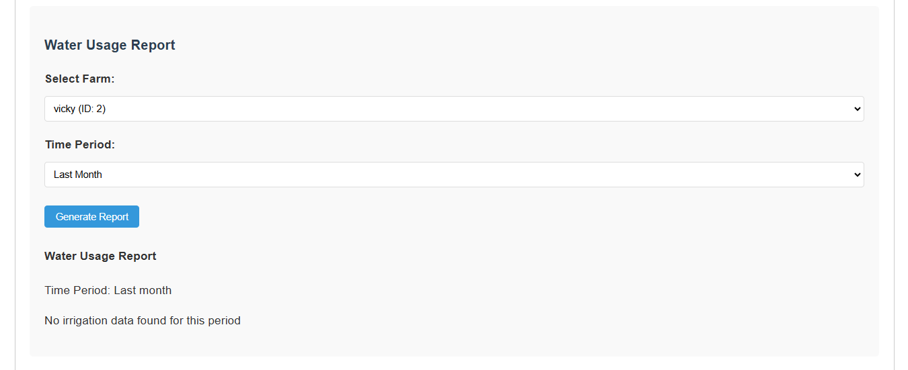
SCREENSHOTS
SENSOR READINGS
FARM ANALYTICS

Slide 13
CONCLUSION AND FUTURE ENHANCEMENT
The Smart Farming Database Management System improves agricultural efficiency by storing and analyzing key farm data. It enhances crop tracking, automates data collection, and supports timely decisions through real-time alerts and analytics.
Future Enhancements
Mobile App for field updates.
AI Prediction for crop yield and pest alerts.
Stored Procedures for automatic rule checks.
Cloud Sync for multiple device access.
Voice Input & GIS Mapping for ease and visualization.

Slide 14


